Slide 1
EDA CREDIT ASSIGNMENT
Analysis of Banking and Financial service Data for Loan Process

Slide 2
Problem Statement
Loan providing Companies finds hard to decide which loan application are to be approved, cancelled or delayed.
Some customers take advantage and they become a defaulters(Stop paying the due) which is a loss for the loan providers.
Risks involved are:
If the customer repays the loan, then not accepting the loan is a loss of customer for the loan provider.
If the customer does not repays the loan, then accepting the loan is a financial loss for loan providers.
Find the pattern of defaulters, reason for the default. If they have difficulties in paying the instalments.
Help the loan providers to decide how to treat the defaulters i.e., to deny the loan, reduce the loan amount, lend at high interest rate, increase the tenure, etc.
To make sure customer capable of repaying are not rejected.

Slide 3
Data Sourcing
There 3 files provided:
Application.csv: for current loan application details
Previous_application.csv: data regarding the previous loan for the same applicant
Columns_description
Load two different csv files in separate dataframe.
Clean the data separately before merging the two data frames.

Slide 4
Data Cleaning
Fix Columns and rows:
Columns “FLAG_DOCUMENT_2” to “FLAG_DOCUMENT_21” have been reduced to one column “DOCUMENT_COUNTS”
Columns that has more than 30% of missing data are removed.
Few columns like CODE_GENDER, has XNA as values. This XNA has been converted to NaN value.
Unneccesary columns like count of children, who accompanied the client are removed.

Slide 5
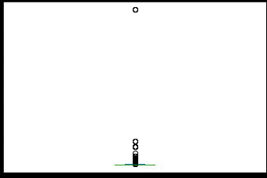
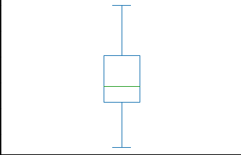
Data Cleaning
Normalised region population has over precisions-values are rounded to 3 precisions.
Outliers :
Income has approx.8% of outliers, we have set the outliers to 99th quantile value to get a clear graph of income. Since high incomed clients are also valid data points, we have not removed them.

Slide 6
Outliers
Count of family members are pretty high for few cases, which seems incorrect values.
Values more than 5 are considered outliers and have been removed.
Observations 30DPD has few outliers above 50 which seems incorrect values.
Observations 60DPD has approx. 16500 clients with more than 10 observations
These outliers has been removed
As these data could be useful, for analysis purpose we have marked them to 10

Slide 7
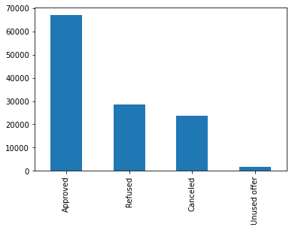
UniVariate analysis
Categorical Unordered Variables:
Contract Type – cash loans has high in number than revolving loans.
Gender – more application found in Female clients than in Male.
Family Status – more applications in married section than any other.
Employment – more Working clients have applied for loan. Commercial associates and pensioners has almost equal.
If the client has ongoing previous loan, they are less in number for current loan than for other.
Most of the applicants have got their previous loan applications approved.

Slide 8
Categorical Ordered Variables:
Age Group – middle and above middle aged group clients have applied for maximum loans .
Education – Secondary/ Secondary special clients have more in numbers than any other. Higher secondary has around 250000. rest all are very few.
Numerical Variables:
1. All numerical variables have equal distribution over Target variable

Slide 9
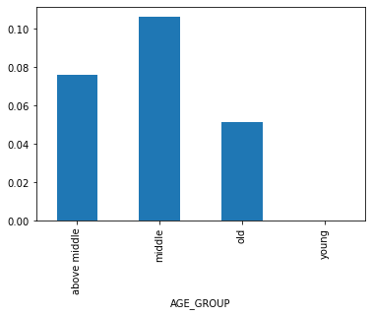
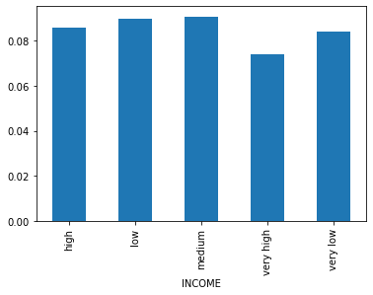
BiVariate Analysis
Age group:
Middle aged people(age 20 - 40) have got more difficulties in paying due.
As these are valid customers, their tenure can be increased along with an insurance.
Income:
All income group have nearly same level of difficulties.
Low and medium incomers seems to have bit higher difficulties than high and very low incomers.
Very high incomers have comparatively low difficulties than others

Slide 10
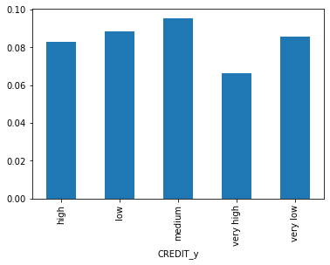
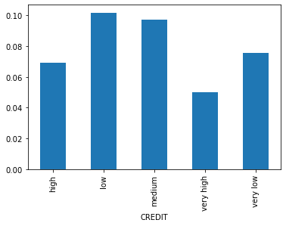
Previous application Credit:
1. Medium credit amount provided customers are more likely become defaulters.
2. Low credit amount has little less than medium.
3. High and very low credit amount has equal number of defaulters
4. Very high amount have very low defaulters.
Current application credit:
Low credit amount has higher frequency of defaulters.
Medium has little bit lesser frequency than low credit.
Very low is slightly more than high credit.
As in previous loan application very high has low defaulters.

Slide 11
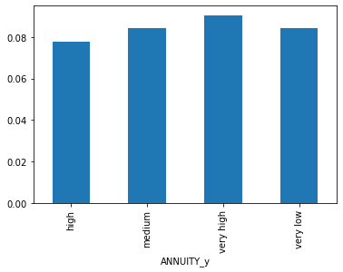
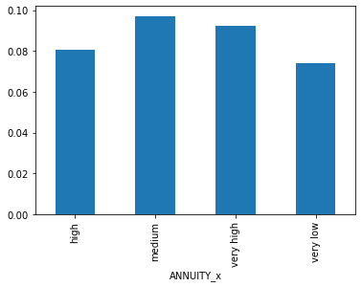
Previous application Annuity:
Very high annuity has more defaulters.
Medium and very low annuity are equal and slightly lesser than very high.
High annuity has bit lesser than medium annuity.
Current Application Annuity:
Medium has more defaulters.
Very high has bit lesser than medium.
High annuity has lesser than very high but more than very low group.
Very low annuity has low defaulters.

Slide 12
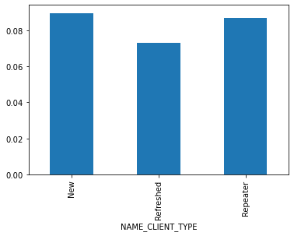
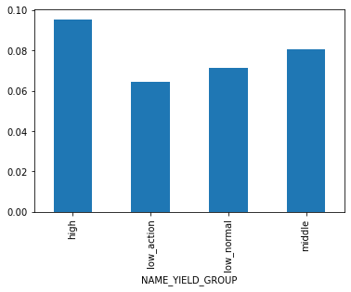
Client Type:
New and repeater clients for previous application are found to have more defaulters.
Refreshed clients have lesser defaulters.
Interest rate:
High interest rate has high defaulters.
Middle interest rate has bit less defaulters than high.
Low interest rate has low default cases.

Slide 13
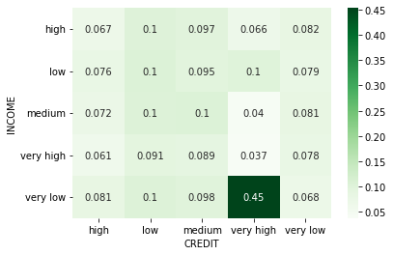
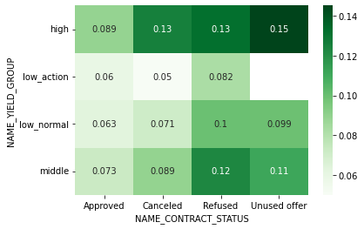
Multi-Variate analysis
Credit vs income vs target:
Very low incomers who bought very high credit amount are those who have more difficulties in paying the due.
Interest Rate Vs contract status vs target:
If the interest rate is high, customers seems to refuse the contract or the customers couldn’t repay the due and get rejected.

